Slide 1
Conflict Resolution Workshop LEAP
Virginia Harwood - Durham College

Slide 2
Session Objectives
Identify the common causes of conflict within a program team;
Project your own desire to collaborate;
Assess the differences between positions and interests;
Move people from competitive to cooperative communication.

Slide 3
What’s Your Headline?

Slide 4
Create Your Headline
Interview a partner (name, college, program)
What brings you to this session?
Any specific type of conflict in your program team – good and not so good?
Collaboratively create headlines for you and your partner (may include conflict issue)

Slide 5
Conflict – How do you see it?

Slide 8
Can conflict be??

Slide 9
Your turn
In groups define conflict
Your challenge – define it without using negative terms
Once you agree on an definition write it on your flipchart
An image works too!
Post on the wall

Slide 10
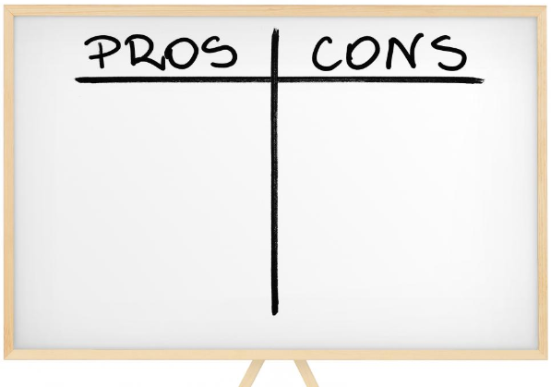
Pros and Cons of conflict

Slide 11
Barriers to Conflict Resolution

Slide 14
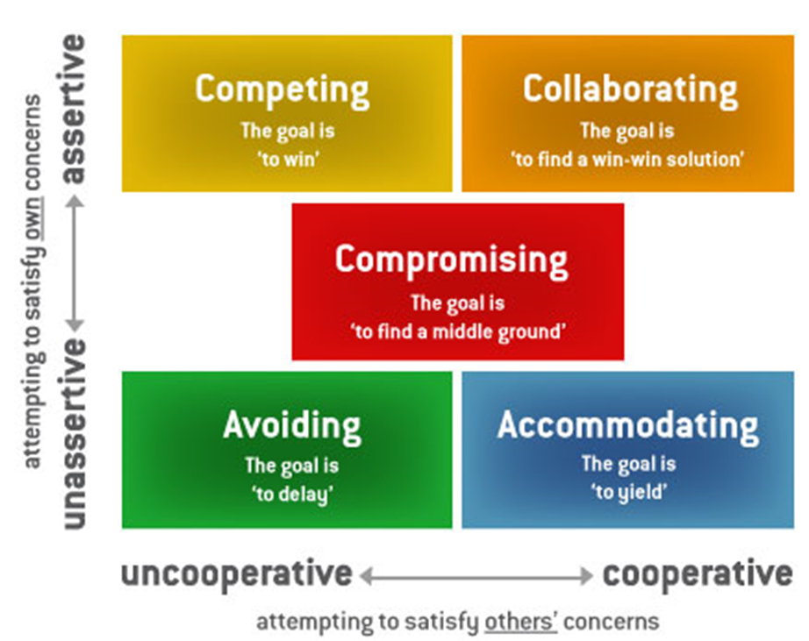

Slide 16
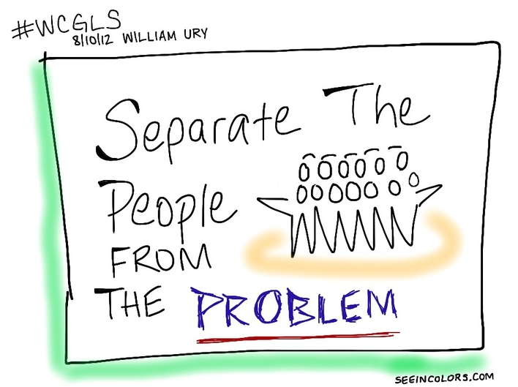

Slide 19
What vs. Why
Positions
Interests
What we WANT as an outcome
The more we defend out position the stronger we hold onto the position
Identity and ego can become attached
Growing emotions cloud reasoning
What is important as an outcome
REASONS WHY the outcome is important
Interests lie underneath what we say we want
Reveal our hopes, needs, values, beliefs, and expectations

Slide 23
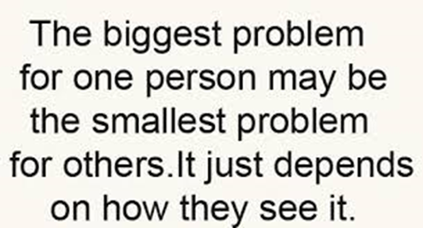
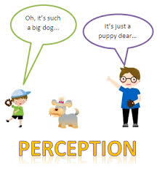

Slide 24
Top 10

Slide 25
Layers of conflict are like an onion

Slide 26
Positions ~ Interests ~ Needs
It is important to be aware about the distinction between positions and interests:
• Positions are what people say they want in a conflict.
• Interests refer to what people really want, and what motivates them.
• Needs are non-negotiable

Slide 27
Focus on Interests not Positions

Slide 28
Getting at Interests - Dialogue
The art of questioning:
Probing questions – The search for deeper meaning or a clearer example: “Can you tell me more about…?”
Clarifying questions – The search for clarity or better understanding: “What do you mean by…?”
Consequential questions – The search for prospective insight: “What do you think would happen if…”

Slide 29
Getting at Interests
Open-ended questions
They allow the person responding to answer with a variety of answers. It gives them control of the conversation and room to express feelings and underlying interests.

Slide 31
What, Where, When, How, & Why?
“Why”
“Why not”
“Tell me more about….”
“What…..”
“How do you feel about…..”
“Questions that look forward rather than back….”
Probe to reveal real goals, desires, wants and needs
Get people thinking about what they REALLY want and WHY
Allows the team to move to exploring options

Slide 32
Dialogue
When we engage in dialogue we keep an open mind, ask questions, and listen to the answers.

Slide 33
Let’s Practice
Partners – Find comfortable location to talk
Partner with largest shoe size begins
Ask your partner a topic question
Example: What do you like about your job?
The other partner can answer, or answer and follow-up with another question
Challenge – see how long you can engage using the topic question as the foundation
WHAT WHERE WHEN HOW WHY

Slide 34
Brainstorm ALL options for the issue

Slide 35
Evaluate ALL Options Generated

Slide 37
Your Own Real Play

Slide 38
Revisit – Conflict How You See it?

